Slide 1

센서응용
Gi Sook Jung, Ph.D
School of Computer Science and Engineering
College of IT Engineering, KNU

Slide 2
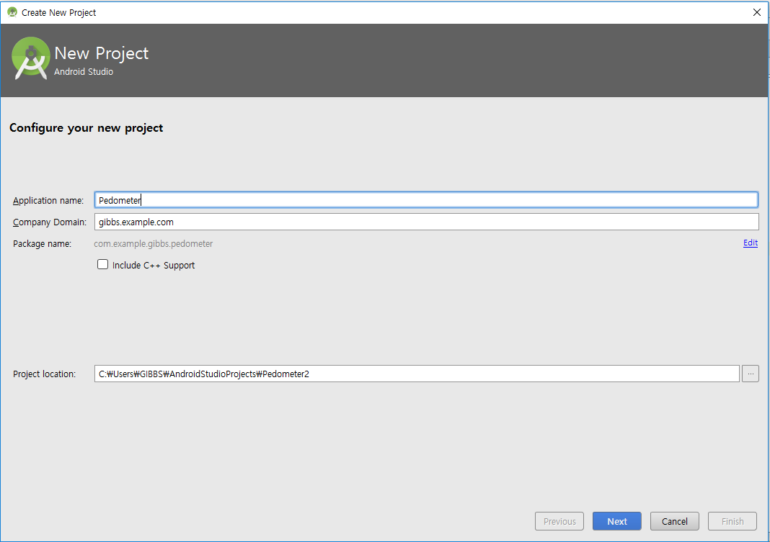
만보계
가속도 센서를 이용한 아주 간단한 만보계 작성
  Y축 방향의 값의 변화를 계산하여 걸음 수를 계산
Pedometer 프로젝트를 생성

Slide 3
Layout
Pedometer
/res/layout/activity_main.xml
<RelativeLayout xmlns:android="http://schemas.android.com/apk/res/android"
xmlns:tools="http://schemas.android.com/tools" android:layout_width="match_parent"
android:layout_height="match_parent" android:paddingLeft="@dimen/activity_horizontal_margin"
android:paddingRight="@dimen/activity_horizontal_margin"
android:paddingTop="@dimen/activity_vertical_margin"
android:paddingBottom="@dimen/activity_vertical_margin" tools:context=".MainActivity">
<TextView android:layout_width="wrap_content"
android:layout_height="wrap_content"
android:text="0"
android:id="@+id/steps"
android:layout_centerVertical="true"
android:layout_centerHorizontal="true"
android:textSize=“200dp" />
<TextView
android:layout_width="wrap_content"
android:layout_height="wrap_content"
android:text="gx"
android:id="@+id/gx"
android:layout_alignParentBottom="true"
android:layout_alignParentLeft="true"
android:layout_alignParentStart="true" />

Slide 4
Layout
Pedometer
/res/layout/activity_main.xml
<TextView
android:layout_width="wrap_content"
android:layout_height="wrap_content"
android:text="gy"
android:id="@+id/gy"
android:layout_alignParentBottom="true"
android:layout_centerHorizontal="true" />
<TextView
android:layout_width="wrap_content"
android:layout_height="wrap_content"
android:text="gz"
android:id="@+id/gz"
android:layout_alignParentBottom="true"
android:layout_alignParentRight="true"
android:layout_alignParentEnd="true" />
</RelativeLayout>

Slide 5
만보계
Pedometer
MainActivity.java
public class MainActivity extends AppCompatActivity {
private TextView gx, gy, gz;
private TextView stepsTextView;
private SensorManager sensorManager;
private float previousY, currentY;
private int steps;
int threshold;

Slide 6
만보계
Pedometer
MainActivity.java
@Override
protected void onCreate(Bundle savedInstanceState) {
super.onCreate(savedInstanceState);
setContentView(R.layout.activity_main);
gx = (TextView) findViewById(R.id.gx);
gy = (TextView) findViewById(R.id.gy);
gz = (TextView) findViewById(R.id.gz);
stepsTextView = (TextView) findViewById(R.id.steps);
threshold = 10;
previousY = currentY = steps = 0;
sensorManager = (SensorManager) getSystemService(SENSOR_SERVICE);
sensorManager.registerListener(stepDetector,
sensorManager.getDefaultSensor(Sensor.TYPE_ACCELEROMETER),
SensorManager.SENSOR_DELAY_NORMAL);
}

Slide 7
만보계
Pedometer
MainActivity.java
private SensorEventListener stepDetector = new SensorEventListener() {
@Override
public void onSensorChanged(SensorEvent sensorEvent) {
float x = sensorEvent.values[0];
float y = sensorEvent.values[1];
float z = sensorEvent.values[2];
currentY = y;
if(Math.abs(currentY - previousY) > threshold) {
steps++;
stepsTextView.setText(String.valueOf(steps));
}
gx.setText(String.valueOf(x));
gy.setText(String.valueOf(y));
gz.setText(String.valueOf(z));
previousY = y;
}
@Override
public void onAccuracyChanged(Sensor sensor, int accuracy) {
}
};

Slide 8
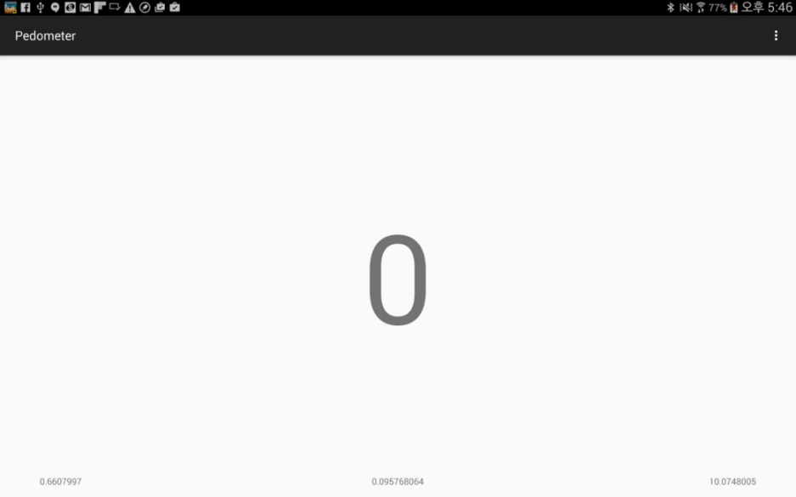
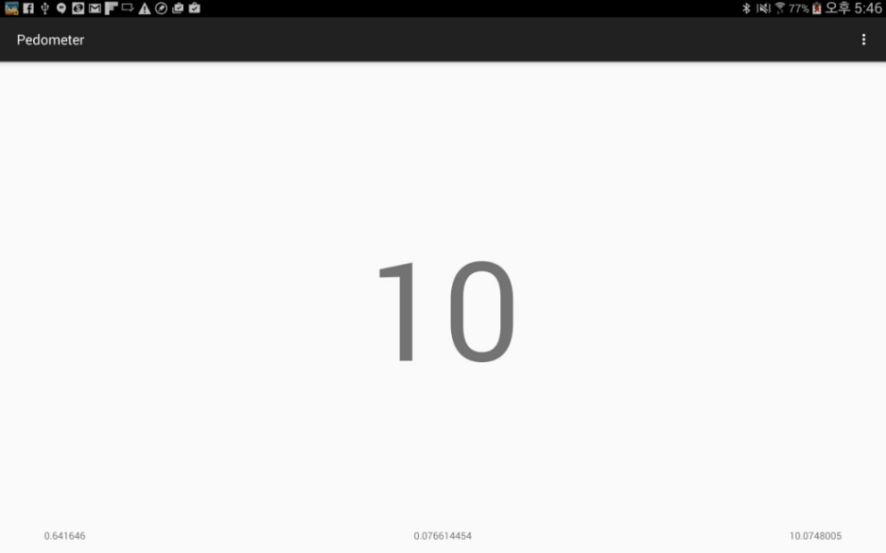
만보계
실행결과
Notes:
왼쪽 : 실제로 안드로이드 기기(Phone)를 연결하여 테스트 한 결과 (15년 자료)
오른쪽 : 에뮬로이터 결과값 (16년 자료) -> 삭제함

Slide 9


